Slide 1
Evaluating Approaches to Evolving Neural Reversi Players
Anna Porter
Research Advisor: Dr. Rob LeGrand
Summer II 2018

Slide 2
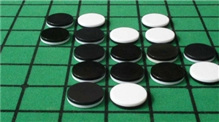
Reversi
8x8
64 identical pieces
Initial boardstate
Flips
Legal moves
Passing
No voluntary passing
Score
https://shop.chess.co.uk/Othello-Classic-Board-Game-Reversi-p/cb05120.htm

Slide 3
Flip example
All 8 Directions
More than one at a time

Slide 4
Flip example
All 8 Directions
More than one at a time

Slide 5
Neural Network Example
Inputs
W_{0,1,0}= 1.25
Weights: layer, destination, origin
W_{0,1,1}= 0.5
1
Neuron 1
W_{1,1,1}= 3
W_{0,2,1} = -0.75
Output Neuron
W_{1,1,2}= 4
W_{0,1,2} = 0.25
W_{0,2,2} = 1.5
Neuron 2
W_{1,1,0}= 2.5
x=-1
W_{0,2,0}= -2
Hidden Layer

Slide 6
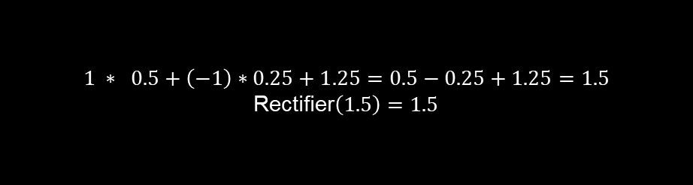
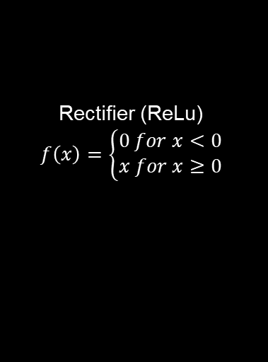
Neuron 1
Inputs
W_{0,1,0}= 1.25
W_{0,1,1}= 0.5
1
Neuron 1
1.5
W_{0,1,2} = 0.25
$$1 ∗ 0.5+\left(−1\right)∗0.25+1.25=0.5−0.25+1.25=1.5$$
Rectifier$\left(1.5\right)=1.5$
-1
Rectifier (ReLu)
$$f\left(x\right)=\left\{\begin{aligned}0 for x<0 \\ x for x≥0\end{aligned}\right.$$

Slide 7
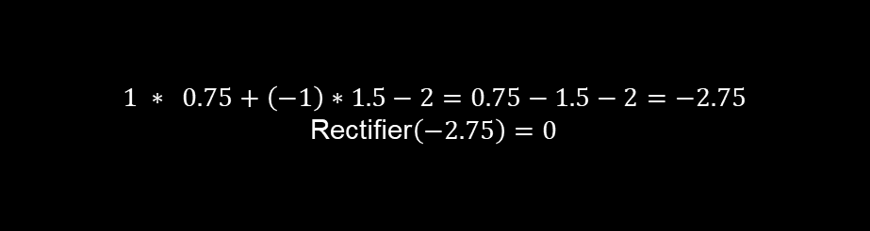
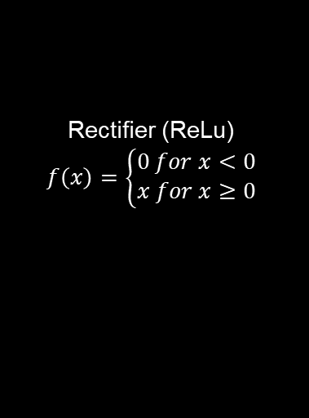
Neuron 2
Rectifier (ReLu)
$$f\left(x\right)=\left\{\begin{aligned}0 for x<0 \\ x for x≥0\end{aligned}\right.$$
Inputs
$$1 ∗ 0.75+\left(−1\right)∗1.5−2=0.75−1.5−2=−2.75$$
Rectifier$\left(−2.75\right)=0$
1
W_{0,2,1} = -0.75
W_{0,2,2} = 1.5
Neuron 2
0
-1
W_{0,2,0}= -2
Notes:
Make the output here negative to demonstrate other condition of rectifier

Slide 8
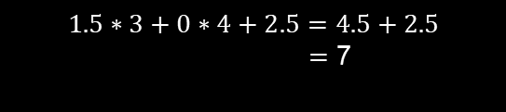
Output Neuron
1.5
$$1.5∗3+0∗4+2.5=4.5+2.5$$ $=$ 7
W_{1,1,1}= 3
Output Neuron
W_{1,1,2}= 4
0
W_{1,1,0}= 2.5

Slide 9
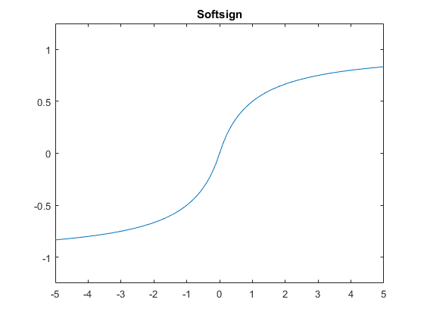
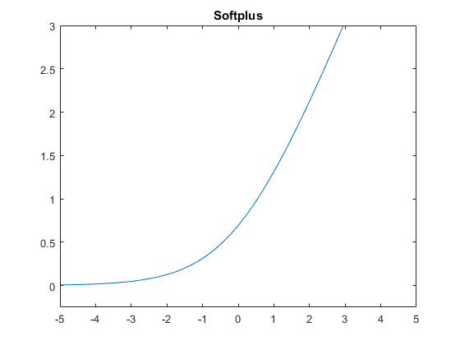
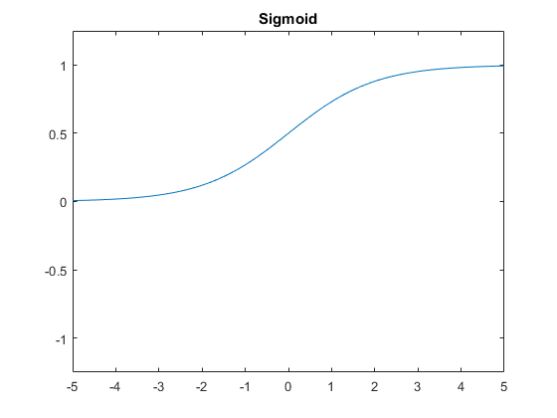
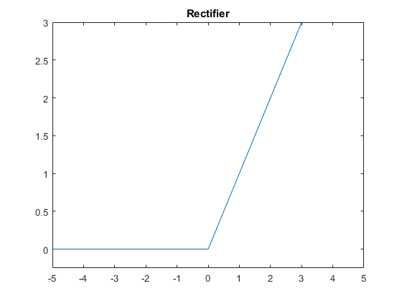
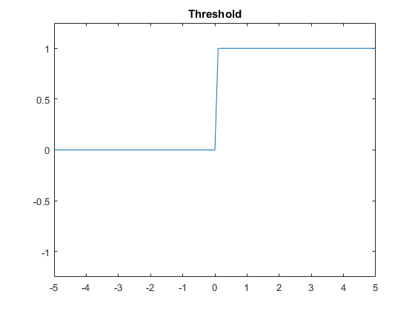
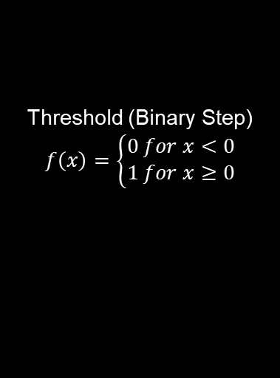
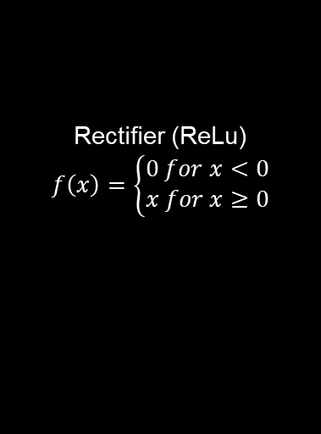
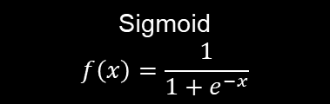

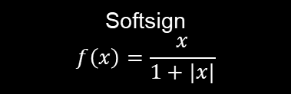
Activation Functions
Softsign
$$f\left(x\right)=\frac{x}{1+|x|}$$
Softplus
$$f\left(x\right)=ln({1+e^{x})}$$
Sigmoid
$$f\left(x\right)=\frac{1}{1+e^{−x}}$$
Rectifier (ReLu)
$$f\left(x\right)=\left\{\begin{aligned}0 for x<0 \\ x for x≥0\end{aligned}\right.$$
Threshold (Binary Step)
$$f\left(x\right)=\left\{\begin{aligned}0 for x<0 \\ 1 for x≥0\end{aligned}\right.$$

Slide 10
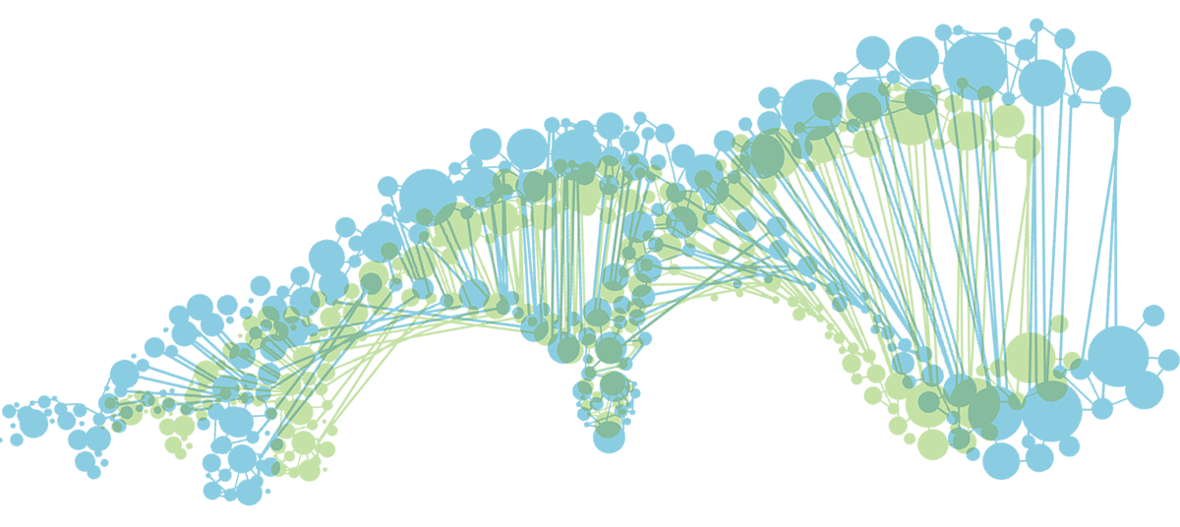
Genetic Algorithm
currentPopulation ← Generate initial population
For whichGeneration ← 1 to numGenerations:
For each organism in currentPopulation:
Play Reversi against 6 neighbors as Black
For each organism in currentPopulation:
Select parents using fitness score based on Reversi results
Crossover parent genes
Mutate genes
Create a new organism in newPopulation using genes
currentPopulation ← newPopulation
If whichGeneration mod 1000 = 0:
Save population for later evaluation
https://www.frontiersin.org/journals/genetics

Slide 11
Fitness Score
Win: 64 points
Loss: 0 points
Draw: 32 points
Pieces Controlled: x points
Wins * 64 + ties * 32 + pieces
Notes:
Add example of fitness score

Slide 12
Parent Selection Example
Parent | Fraction | Percentage
Father 1 | 323 / 1478 | 21.85%
Father 2 | 0 / 1478 | 0%
Father 3 | 200 / 1478 | 13.53%
Father 4 | 475 / 1478 | 32.14%
Father 5 | 256 / 1478 | 17.32%
Father 6 | 224 / 1478 | 15.16%
Father1
423
Father1
323
Father6
324
Father2
100
Father6
224
Father2
0
Mother
Mother
Father5
356
Father3
300
Father5
256
Father3
200
Father4
575
Father4
475

Slide 13
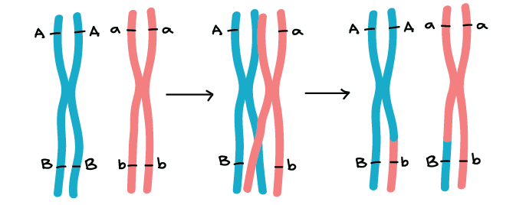
Crossover Example
W_{0,1,0} = 1
W_{0,1,1} = 7
W_{0,1,2} = 4
W_{1,1,0} = 3
W_{1,1,1} = 9
W_{1,1,2} = 6
Mother
W_{0,2,0} = 5
W_{0,2,1} = 2
W_{0,2,2} = 8
W_{0,1,0} = 8
W_{0,1,1} = 7
W_{0,1,2} = 1
W_{1,1,0} = 3
W_{1,1,1} = 9
W_{1,1,2} = 4
Child
W_{0,2,0} = 3
W_{0,2,1} = 9
W_{0,2,2} = 8
W_{0,1,0} = 8
W_{0,1,1} = 6
W_{0,1,2} = 1
W_{1,1,0} = 5
W_{1,1,1} = 2
W_{1,1,2} = 4
Father
W_{0,2,0} = 3
W_{0,2,1} = 9
W_{0,2,2} = 7
https://www.khanacademy.org/science/biology/classical-genetics/chromosomal-basis-of-genetics/a/linkage-mapping

Slide 14
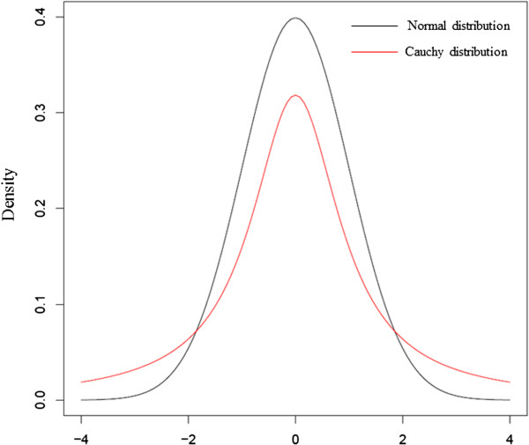

Mutation
Normal Shake: Mean 0, SD 1
Cauchy Shake: Mean 0, SD 1
Uniform Shake: $−\sqrt{3}$ to $\sqrt{3}$
1% replace
Gene = 0.75
Random Number = 0.6
Mutation(gene) = 0.75 + 0.6 = 1.35
https://www.researchgate.net/figure/Comparison-of-standard-normal-distribution-and-standard-Cauchy-distribution_fig6_263584248
Notes:
Doing an actual example
Find a new picture or make my own

Slide 15
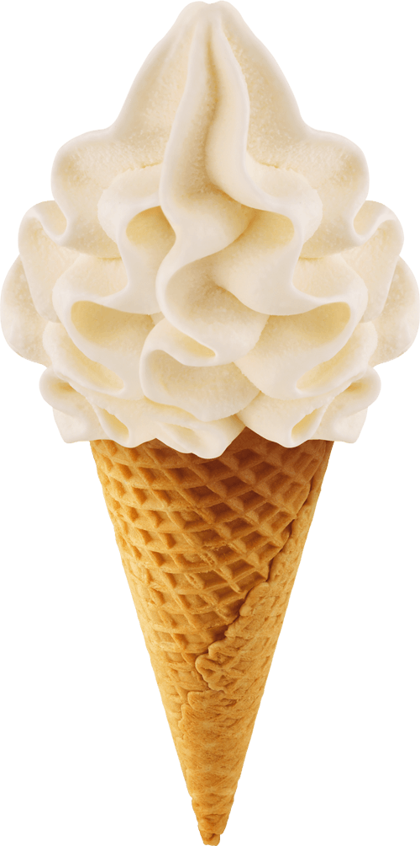
Vanilla Configuration
Reversi Board: 8x8
Inputs: -1, 0, 1
Population Size: 10x10
1 hidden layer 8 neurons
Softplus
One move ahead
Normal Distribution Initialization
(Mean: 0, Standard Deviation: 1)
Parent Selection 6 neighbors, weighted fitness
Light blue on each graph

Slide 16
Variants
Activation Functions
Sigmoid
Softsign
Softplus
Rectifier
Threshold
Layer Sizes
1
8 – 1 (vanilla)
8 – 3 – 1
16 – 4 - 1
Mutation Types
Normal Shake (vanilla)
Cauchy Shake
Uniform Shake
Normal Shake then Replace
Parent Selection
6 Fit Prob (vanilla)
7 Fit Prob
Both 7 Fit Prob
Best Mother 6
Best Mother 7
Best Both 7 (no repetition)
Probabalistic
Deterministic

Slide 17
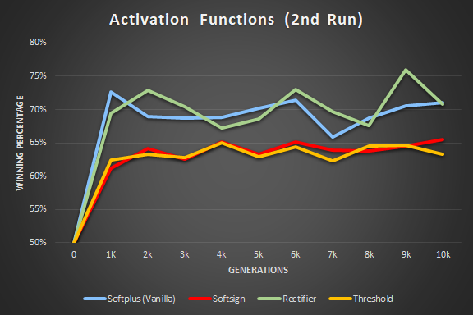
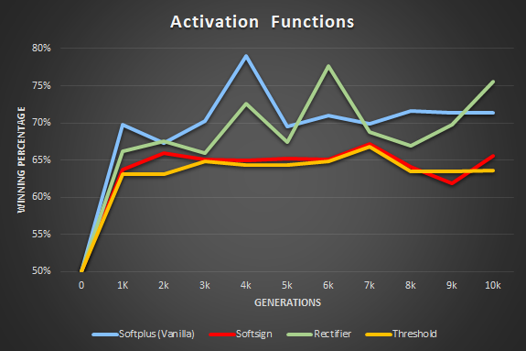
Activation Function Comparison
Similar shape, similar results
Rectifier & Softplus
Rectifier & Threshold
Most wins: Softplus
By generation
Against others
 | Recitifier | Softplus | Softsign | Threshold | Sigmoid | Total Wins
Rectifier |  | 9347 | 9850 | 10849 |  | 30046
Softplus | 9913 |  | 9979 | 10790 |  | 30682
Softsign | 9416 | 9275 |  | 10368 |  | 29059
Threshold | 8445 | 8462 | 8890 |  |  | 25797
Sigmoid |  |  |  |  |  | 0

Slide 18
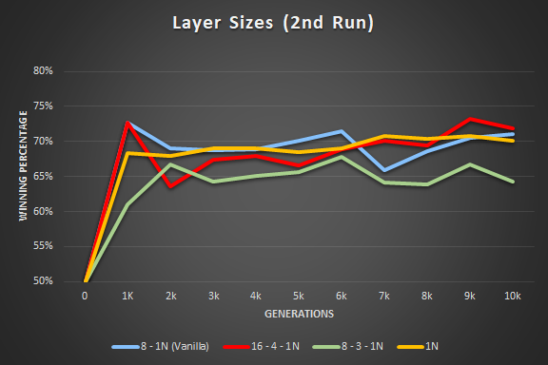
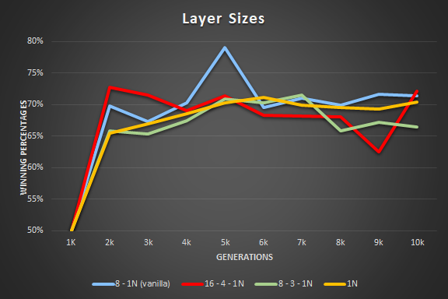
Layer Sizes Comparison
Progress relative to 0 – largely similar
1 Neuron
Most wins
Beat every population
More layers, less wins
Larger networks need more generations
 | 1N | 8 - 1N | 8 - 3 - 1N | 16 - 4 - 1N | Total Wins
1N |  | 10334 | 13212 | 11643 | 35189
8 - 1N | 9099 |  | 12639 | 10650 | 32388
8 - 3 - 1N | 6308 | 6821 |  | 9034 | 22163
16 - 4 - 1N | 7844 | 8761 | 10403 |  | 27008

Slide 19
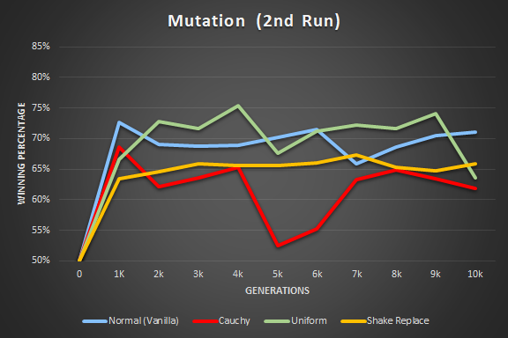
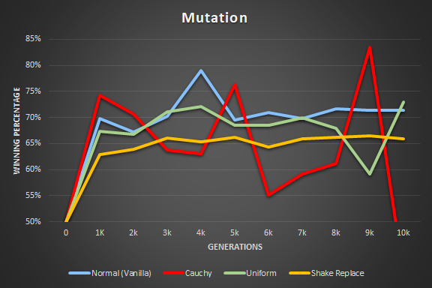
Mutation Comparison
Cauchy – Volatile
Uniform and Shake Replace
Most
Adding a replace mutation
Poorer performance
 | Normal | Cauchy | Uniform | Shake Replace | Total
Normal |  | 17906 | 10570 | 12477 | 40953
Cauchy | 1892 |  | 2547 | 3293 | 7732
Uniform | 8861 | 17213 |  | 11917 | 37991
Shake Replace | 7008 | 16276 | 7533 |  | 30817

Slide 20
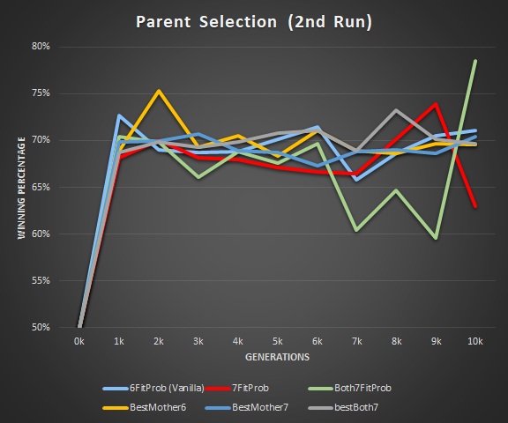
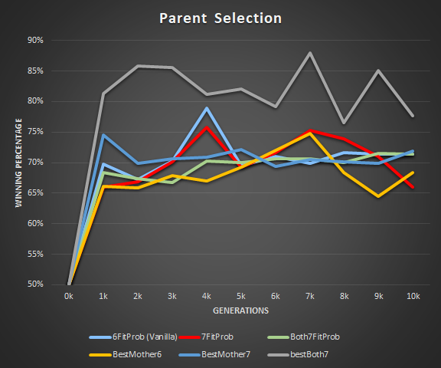
Parent Selection Comparison
Notice vertical scale and height
Best Both 7
Outlier for run 1
But not for run 2
Largely similar otherwise

Slide 21
Parent Selection Comparison
 | 6FitProb | 7FitProb | Both7FitProb | BestMother6 | BestMother7 | bestBoth7 | Total
6FitProb |  | 12239 | 9249 | 11354 | 8889 | 13559 | 55290
7FitProb | 7170 |  | 6501 | 8067 | 6620 | 6501 | 34859
Both7FitProb | 10241 | 12982 |  | 11665 | 9049 | 14527 | 58464
BestMother6 | 8082 | 11370 | 7885 |  | 7493 | 13559 | 48389
BestMother7 | 10600 | 12808 | 10421 | 11983 |  | 14973 | 60785
bestBoth7 | 5955 | 6226 | 4995 | 5978 | 4589 |  | 27743

Slide 22
Conclusions
Activation Functions: better not to restrict within range
Layer Sizes: Most need more generations for evolution
Mutation: Adding a replace to a normal shake hurts performance
Parent Selection: largely similar

